Slide 1
Performance Evaluation and Hypothesis Testing

Slide 2
Motivation
Evaluating the performance of learning systems is important because:
Learning systems are usually designed to predict the class of “future” unlabeled (= class is not known) data points
In some cases, evaluating alternative models (that we call hypotheses) is an integral part of the learning process
For example, when pruning a decision tree, alternative pruned trees represent different “hypotheses” on how to interpret our data; in neural networks, different network architectures – with different numbers of hidden layers – also represent alternative hypotheses.
Which one is the best predictor of reality?

Slide 3
Issues
Which performance measure we should use?
How well can a classifier be expected to perform on “novel” data, not used for training?
Since a performance measure is an estimate on a sample, how accurate is our estimate?
How to compare performances of different hypotheses or those of different classifiers?

Slide 4
Performances of a given hypothesis
Performances are usually reported in the form of a confusion matrix (also called contingency table)
The table has four cells (in case of binary classifiers):
True Positive (TP): number of positive instances classified as positive by the system
True Negative (TN): number of negative instances classified as negative by the system
False Positive (FP): number of negative instances classified as positive by the system
False Negative (FN): number of positive instances classified as
negative by the system
Notes:
Restyling, spostata formula accuracy in slide succesisva

Slide 5
Venn diagram

Slide 6
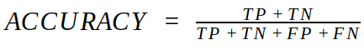
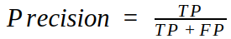
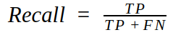
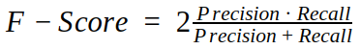
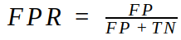
Performances of a given hypothesis
False positive rate
Recommended reading link
Notes:
False positive rate = false positives/total negatives True positive rate = true positives/positives=recall

Slide 7
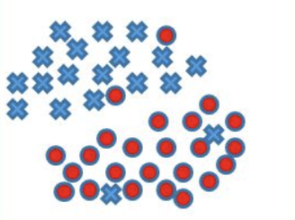
Total instances 43
Total positive 24
Total negative 19
Accuracy | (22+17)/43 =0.907
Precison | 22/24 =0.91
Recall (TPR) | 22/24=0.91
FScore | 0.91
FPR | 2/19 =0,10
TP= | FP=
TN= | FN=
22
2
17
2

Slide 8
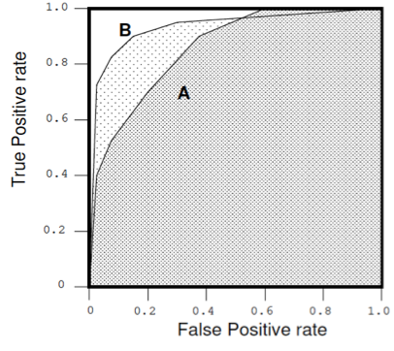
ROC Curve
Receiver Operating Characteristic curve (or ROC curve.) is a graphical plot that illustrates the performance of a binary classifier system. The curves are created by plotting the recall (True Positive rate; TPR) against the false positive rate (FPR) at various system settings (parameters, the dimension of learning set, etc). One would aim at high recall and low FPR. A and B here represent two alternative runs of the same ML algorithm (with different parameters and settings), or two different algorithms.
The Area Under the ROC (AUROC or AUC) ROC is a probability curve and AUC represents a measure of «separability». It tells how much model is capable of distinguishing between classes. Higher the AUC, better the model is at predicting 0s as 0s and 1s as 1s.

Slide 9
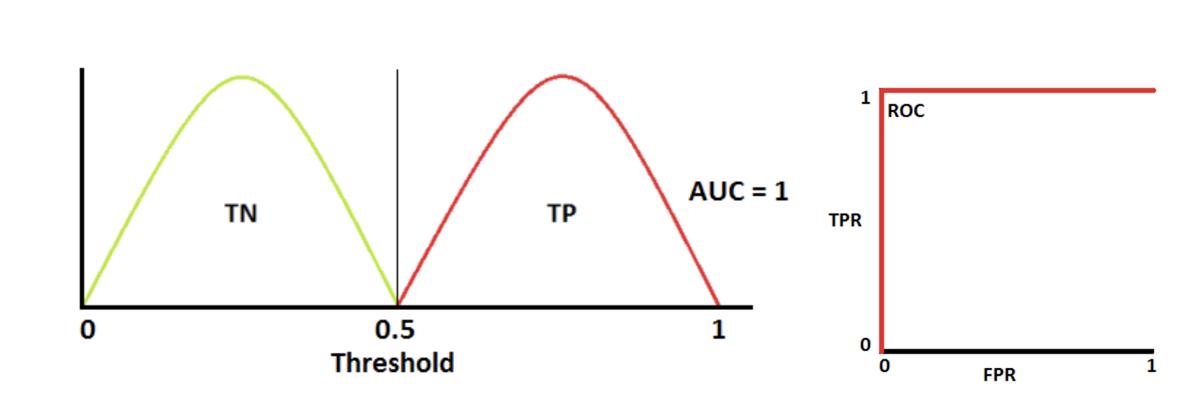
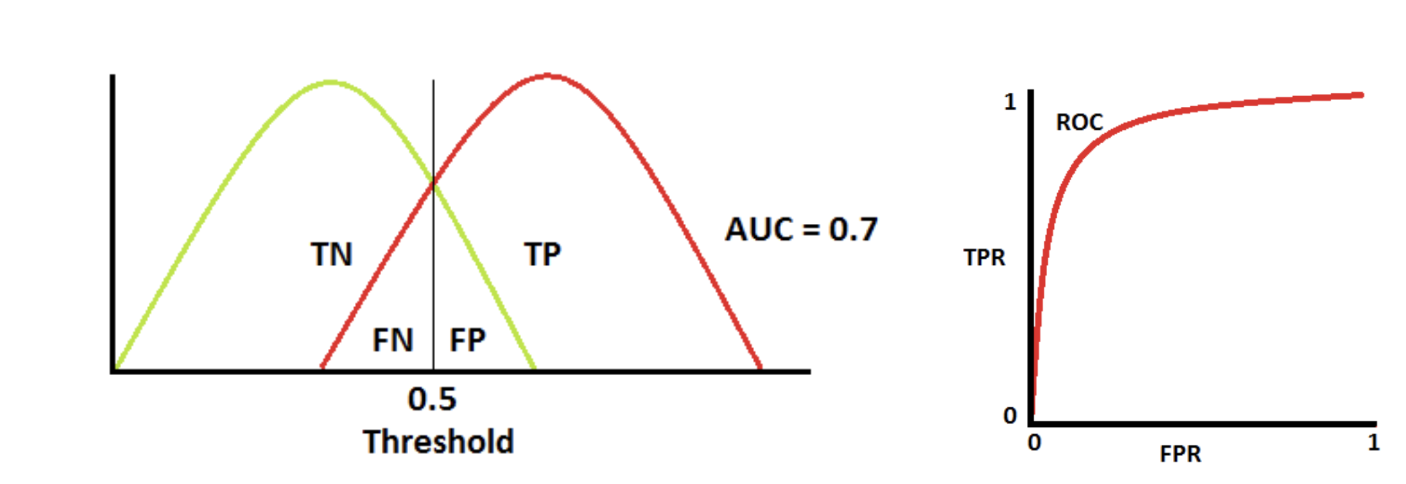
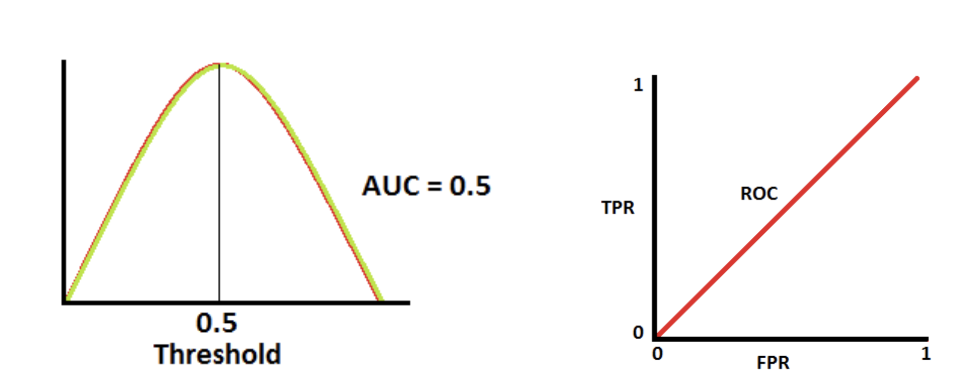
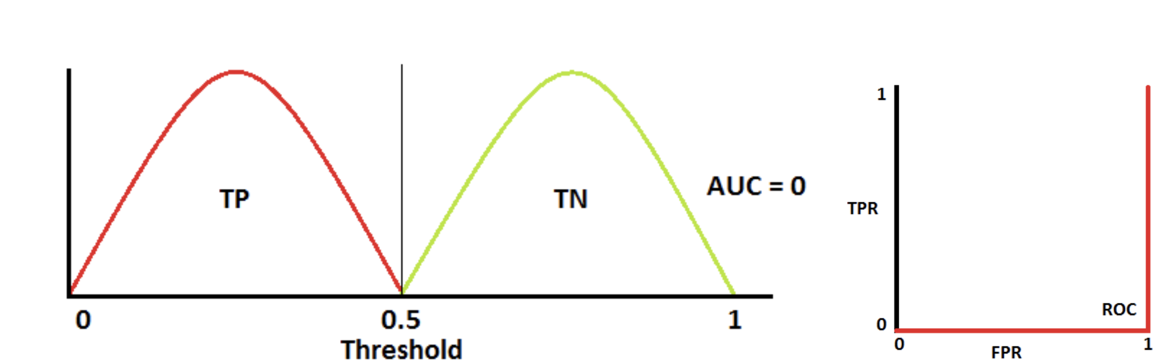
Area Under the ROC curve
Green and red curves represent
the probability that a given model
classifies an istance as positive
or negative given some features (e.g,
% of passed exams in first year as
a predictor of student drop-out).
TP
FP
⬅Here the model is reciprocating the classes!

Slide 10
Precision-Recall Curve
Precision-Recall curve (or PR curve.) is a graphical plot that illustrates the performance of a binary classifier system. The curve is created by plotting the recall (True Positive rate; TPR) against the precision at various system settings (parameters, the dimension of learning set, etc).
The Area Under the Precision-Recall curve (AUPR) has an intuitive meaning just like AUROC. However: AUROC is better for a binary balanced problem. AUPR is better for a binary imbalanced problem.
Notes:
Slide Nuova: aggiunta descrizione dell’ P-R Curve, plot molto utilizzato nel caso di forte sbilanciamento nelle classi. Chiarimento di quando usare la ROC e la PR.

Slide 11
Learning Curve
Plots accuracy vs. size of the training set
Has maximum accuracy nearly been reached or will more examples help?
Is one system better when training data is limited?
Most learners eventually converge to optimal given sufficient training examples
100%
optimal
Test Accuracy
Dotted line is some baseline
Random guessing
# Training examples

Slide 12
Issues
Which performance measure we should use?
How well can a classifier be expected to perform on “novel” data, not used for training?
Since a performance measure is an estimate on a sample, how accurate is our estimate?
How to compare performances of different hypotheses or those of different classifiers?

Slide 13
Evaluating a model
ROC, P/R, and Accuracy not enough
How well will the learned classifier perform on novel data?
Performance on the training data is not a good indicator of performance on future data
Notes:
Vorrei passare al termine Ipotesi (al posto di modello) gradualmente, almeno quando si arriva al sample e al true error

Slide 14


Example
Testing on the training data is not appropriate
The learner will try to fit at best on available data, and will not learn to generalize
Possibly, it will misclassify new unseen instances
Learning set
Test: is it a lion?
What is the problem here? Not enough variance in the data

Slide 15
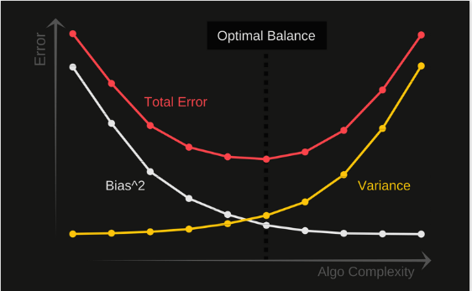
The Error
Bias-variance decomposition
The error is just made up of Bias and Variance.
Total Error = Bias² + Variance + Irreducible Error
The bias is an error from erroneous assumptions in the learning algorithm. The variance is an error from sensitivity to fluctuations in the training set.
Irreducible error is the error that can’t be reduced by creating good models
A good model has to minimize the error (low bias and variance!)
Will explain later this formula
Notes:
https://towardsdatascience.com/understanding-the-bias-variance-tradeoff-165e6942b229

Slide 16
Bias
5 types of bias
Sample bias (collected data are not representative) Ex: your goal is to create a model that can operate security cameras at daytime and nighttime, but train it on nighttime data only.
Exclusion bias (we are excluding some relevant feature) Ex: In the famous Titanic problem where we predict who survived and who didn’t. One might disregard the passenger id of the travelers as they might think that it is completely irrelevant to whether they survived or not. Little did they know that Titanic passengers were assigned rooms according to their passenger id.
Observer bias (tendency to see what we expect to see) Ex: Cyril Burt, a famous psychologist thought that children from families with low socioeconomic status (i.e. working class children) were also more likely to have lower intelligence, compared to children from higher socioeconomic statuses.

Slide 17
Bias (2)
4. Prejudice bias Ex. Goal is to detect people at work. Your model has been fed to thousands of training data where men are coding and women are cooking. The algorithm is likely to learn that coders are men and women are chefs. Which is wrong since women can code and men can cook.
5. Measurement bias. Ex. Shooting images data with a camera that increases the brightness.
There are no clear-cut methods to prevent bias. Here is a useful
link

Slide 18










Variance (1)
High variance
Low variance
Note that bias here could be that we show only the head of a Lion
- what bias is this?

Slide 19
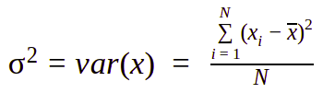
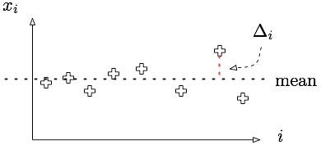
Variance (2)
(for any discrete distribution)
Variance is defined as the mean of squared differences between values of N individual outcomes x_{i} and the mean (x),
i.e. the dispersion around the mean
For infinite values, the sum becomes an integral
Notes:
Restyling

Slide 20
How to reduce the variance?
K-Fold Cross-Validation: a common method (if enough labeled data are available) is to perform several independent splits on learning and test set and then average the performance over these different splits.

Slide 21
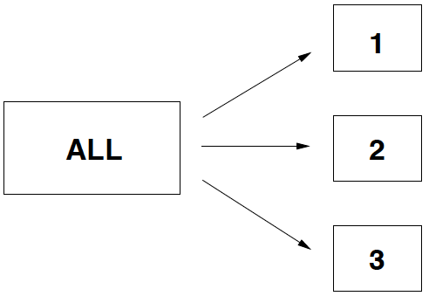
K-Fold Cross-Validation
of a hypothesis (model)
1
Partition all the available labeled data in k equally sized random samples.

Slide 22
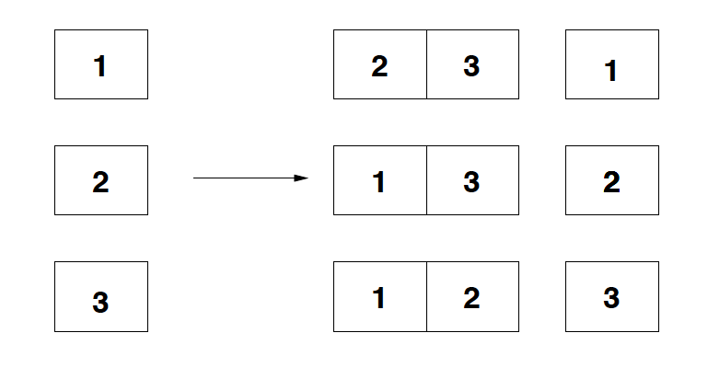
K-Fold Cross-Validation
of a hypothesis (model)
2
At each step i, learn from Learn_{i} and test on Test_{i}, then compute the error (e_{i}) on Test_{i}.
Learn_{i}
Test_{i}
e₁
e₂
e₃

Slide 23
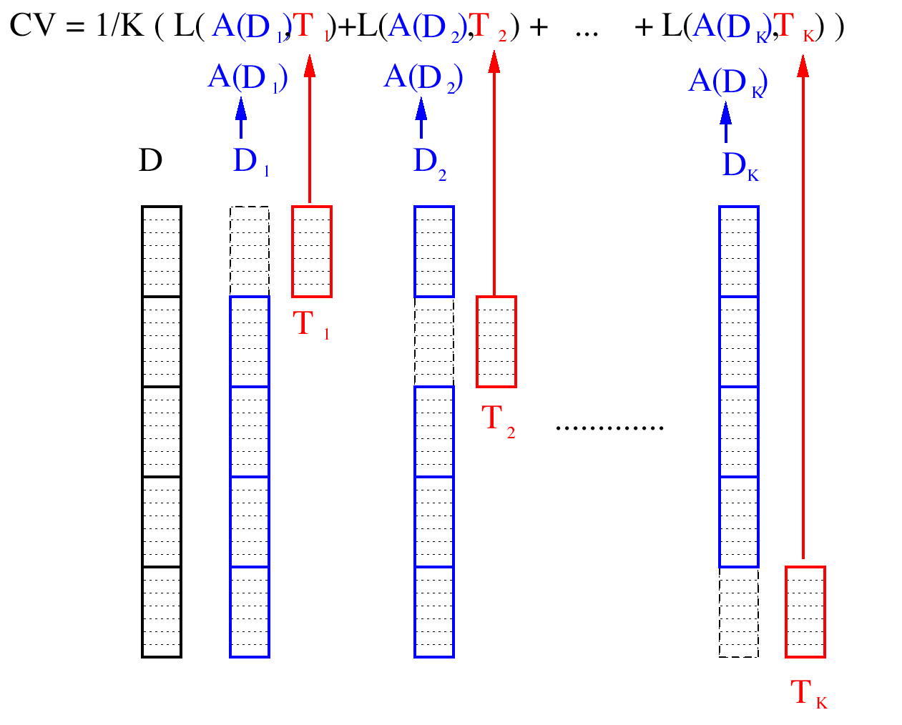
K-FOLD CROSS VALIDATION

Slide 24
Why K-Fold Cross Validation reduces the variance?
Intuitively, it reduces the probability of being lucky, or unlucky, in selecting the test-set
To understand the issue more in detail, we need to introduce the next topic:
testing the accuracy of an error estimate

Slide 25
Issues
Which performance measure we should use?
How well can a classifier be expected to perform on “novel” data, not used for training?
Since a performance measure is an estimate on a sample, how accurate is our estimate?
How to compare performances of different hypotheses or those of different classifiers?

Slide 26
Evaluation:
What is an Estimator?
An Estimator is any function on a sample of the data that is used to estimate some useful qualities of the original data from which the sample is drawn. Formally, an estimator is a function on a sample S:
where x(i) is a random variable drawn from a distribution D, i.e. x(i) ~ D.
We would like to use the sample S to estimate some useful qualities of the original data.
For example, the mean is an estimator
In general, an estimator is any random variable used to estimate some parameter of the underlying population from which the sample is drawn
An obvious question to ask about any estimator is whether «on average» it gives the right estimate
A good estimator has low bias and variance!

Slide 27
Evaluation issues
in a limited data setting
Now we would like to know how good our estimators are.
Estimator Bias:
Bias measures how good our estimator is in estimating the real value.
For example, the observed accuracy of the learned “hypothesis” (model) over the training examples D is a poor estimator of its accuracy over future examples, i.e. we must test the hypothesis on a test set S chosen independently of the training set and the hypothesis.
Estimator Variance:
Variance measures how “jumpy” our estimator is to sample.
Even with a separate test set, the measured accuracy can vary from the true accuracy, depending on the makeup of the particular set of test examples. The smaller the test set, the greater the expected variance.
Notes:
https://users.cs.northwestern.edu/~pardo/courses/eecs349/readings/chapter5-ml.pdf

Slide 28
Estimator Bias (def)
Definition Bias:
The bias of an estimator x is the difference between this estimator's expected value and the true value of the parameter being estimated.
Bias(x) = E[x] - y
An estimator is called unbiased if this difference is zero; i.e., if
E[estimator] = quantity being estimated.
Notes:
https://users.cs.northwestern.edu/~pardo/courses/eecs349/readings/chapter5-ml.pdf,

Slide 29
Estimator Variance (def)
Definition Variance:
The variance of an estimator is the expected squared error between the estimate x and the expected value.
Variance(x) = E[(x - E(x))²]

Slide 30
Questions to be considered
in hypothesis testing
Let h be a model learned by a specific ML algorithm L with some specific hyper-parameters. We denote h as a “hypothesis”, and the objective is to estimate its prediction accuracy. The following are relevant questions:
Q1: Given the observed accuracy of h over a limited sample of test data S, how well does this estimate its accuracy over additional (unseen) instances?
Q2: Given that one hypothesis h₁ outperforms another, h₂,over some sample data S, how probable is it that this hypothesis is more accurate in general (= over the full instance space)?
Q3: When available classified data is limited, what is the best way to use this data to both learn a hypothesis and estimate its accuracy?

Slide 31
Estimating Hypothesis Accuracy
Q1
A better formulation of Q1:
Given a hypothesis h and a data sample containing n instances drawn at random according to distribution D, what is the best estimate of the accuracy of h over future instances drawn from the same distribution?
Need to consider: sample error vs. true error
What is the «probable error» in this accuracy estimate?
Need to consider : confidence intervals (i.e., Δ, the absolute error)
In other terms, if we measure an error rate (sample error) of, say, 20% on a sample test set, the true error rate of h on any sample is not guaranteed to be exactly 20%. Let’s say that it is 20% ± Δ.
Can we estimate the value of Δ?
Notes:
Restyling

Slide 32
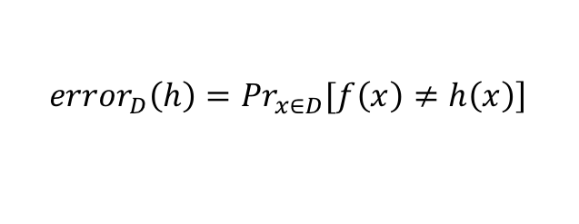
Sample Error and True Error
Definition Sample Error (i.e., error_{s}(h), error rate):
The sample error of hypothesis h(x) for the target function f(x) (the ground-truth classification of instances x in S), on a data sample S is:
where:
n is the number of instances in sample S
r is the number of misclassified instances
h(x) is the classification produced by our current model h
δ( f(x) ≠ h(x) ) = 1 if f(x) ≠ h(x), and 0 otherwise.
Definition True Error (i.e., error_{D}(h), p):
The true error of hypothesis h for the target (unknown) classification function f and distribution D of instances, is the probability that h will misclassify any instance x drawn at random according to D.
$$\left.{error}_{D}\left(h\right)={Pr}_{x∈D}[f\left(x\right)≠h\left(x\right)\right]$$
error_{s}(h) is an estimator of error _{D} (h), which is a probability
So, how good is this estimator?
Notes:
https://users.cs.northwestern.edu/~pardo/courses/eecs349/readings/chapter5-ml.pdf

Slide 33
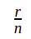
Estimate, probability
and random variables
1
We are given a sample S of n instances, we classify S with h(x) and we measure r errors, we then estimate the error probability of h(x):
error_{S}(h) = P(r errors in n instances) = = 1 - accuracy_{S}(h)
Note: We call S “sample” since it can be any subset X’ of X sampled according to D.
However, r (or ) is a random variable, governed by chance. If we get another sample S’ of n different instances, we may get a different number r’ and a different estimate. In general error_{S}(h) ≠ error_{S’}(h)
A Random Variable can be viewed as the name of an experiment with a probabilistic outcome. Its value is the outcome of the experiment.

Slide 34
Estimate, probability
and random variables
2
A simple experiment for Random Variable:
Make k different sets of trials, in each toss a coin 10 times and measure the number of “head”. Although, as the number of experiments, k, increases, the average number of “head” occurrences tend to ½, in every single trial you will likely obtain different numbers.
In coin tossing, we know that the “real” head rate (the expected value for the fraction of head tosses) is 50%, but in hypothesis testing, we don’t know what is the real error rate. So, how can we get an idea of error_{D} (h) on the entire population X, distributed according to D?

Slide 35
Sample Error & True Error
Is the Sample Error a good estimator for the True Error?
We do not know the “true” error probability however we know that error_{s}(h) is a random variable that follows a binomial distribution with mean p (the unknown true error rate)
Why? What is this “binomial”?

Slide 36
Sample Error & True Error:
Why? What is this “binomial”?
Say p is the (unknown) “true” error probability of h(x) on X. If we have a sample S of n instances, what is the probability that, given instances x in S, f(x) ≠ h(x) for r times??
Even if we do not know the error rate p, each instance x in S has probability p of being misclassified by h(x) and (1-p) of being classified correctly.
The probability of observing r misclassified examples in n instances is then:
# of ways in which
we can select r items
from a population of n

Slide 37
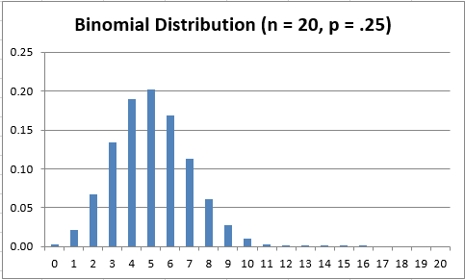
Example:
p is the probability of rain in January
What is the probability of
x rainy days out of 20 days?
The abscissa is the value r, e.g. there is a 20% probability that there will be 5 rainy days out of 20 classifications, 6% probability of 8 out of 20, etc.

Slide 38
Example:
p is the probability that our ML system misclassifies an instance x drawn at random
What is the probability of x errors when classifying 20 instances?
The abscissa is the value r, e.g. there is a 20% probability that there will be 5 errors out of 20 classifications, 6% probability of 8 out of 20, etc.

Slide 39
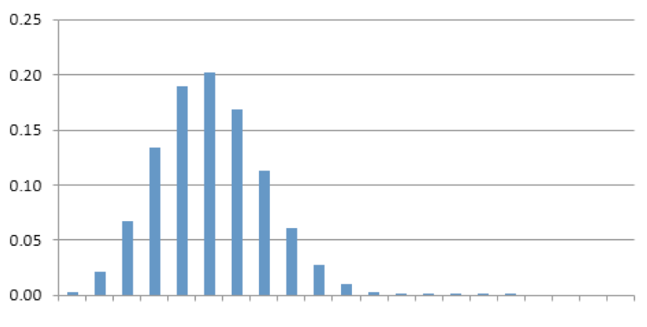
We can normalize and plot r/n
0 0,3 1
Now x is the % of wrongly classified instances

Slide 40
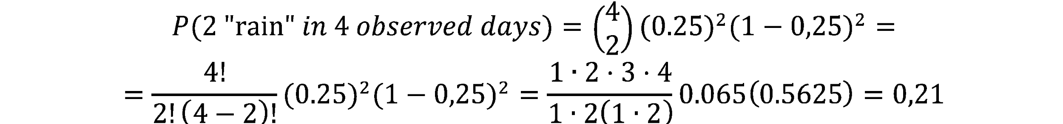
How do we compute these probabilities?
Say we know that p( rain) = 25% (on January)
However, if we watch the weather in 4 consecutive days, we are not sure we will get “rain” 1 time and “not rain” 3 times. The number of observed “rainy days” in each trial of 4 consecutive days is governed by chance.
What is the probability of getting, instead, 2 rainy days in 4 days?
Same formula to estimate the probability of 2 errors over 4 instances, given we know that the true error rate is 25%

Slide 41
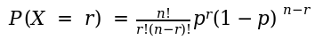
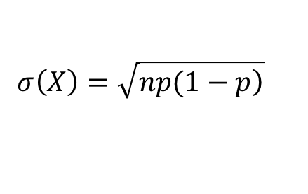
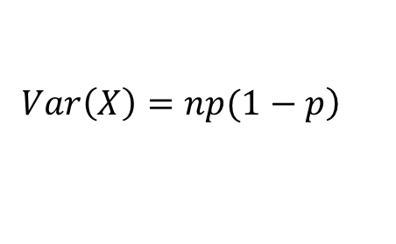
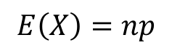
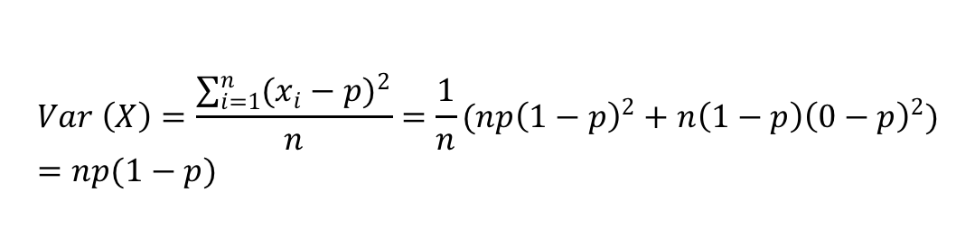
Properties of Binomial distribution
Probability of r errors in n trials
Expected Value of r over n trials:
Variance:
Standard Deviation (STD, SD):
X is a random variable with a binomial distribution
$$E\left(X\right)=np$$
$$\left.Var\left(X\right)=np(1−p\right)$$
$$σ\left(X\right)=\sqrt{\left.np(1−p\right)}$$
$$Var \left(X\right)=\frac{\sum_{i=1}^{n}{{(x_{i}−p)}^{2}}}{n}=\frac{1}{n}(np{\left(1−p\right)}^{2}+n\left(1−p\right){\left(0−p\right)}^{2})=np(1−p)$$

Slide 42
Estimator of an error
Now, we know that X (number of errors in n trials) follows a binomial distribution with unknown mean np. If we sample the error rate on a set of instances S, we obtain a value r/n which is our current estimate error_{S}(h) of error_{D}(h).
Note that the “estimator” error_{S}(h) is also a random variable! If we perform many experiments on different samples S we could get different values.
However, for large enough dimension of the sample S, the expected value of error_{S}(h) (i.e. E[error_{S}(h)]) is the same as for error_{D}(h)!
Why? Because of the Central Limit Theorem

Slide 43
Central Limit Theorem
General Formulation:
The theorem states that the arithmetic mean of a sufficiently large number of experiments of independent random variables, each with a well-defined expected value and well-defined variance, will be approximately normally distributed.
This will hold regardless of whether the source population is normal or skewed (biased), provided the samples size is sufficiently large (usually n > 30)
Furthermore, the mean of all such experiments will (tend to) be the same as the “real” population mean
A Normal distribution (or Gaussian Distribution):
A family of continuous probability distributions such that the probability density function is the normal (or Gaussian) function

Slide 44
Applied to our case:
testing error rate
In our case we know:
a) Experiments are accuracy tests on data samples S_{i}
b) The random variables are the error rates r_{i}/n_{i} observed on these samples S_{i}. They are independent of each other, and they follow a binomial
c) For a sufficiently large number of experiments, the values r_{i}/n_{i} will be approximately normally distributed
d) Their mean value will tend to the “real” (the unknown true value) expected error p over the entire set of instances X

Slide 45
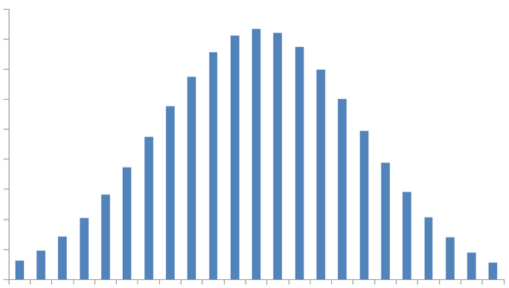
mean(error_{S}(h))→p
p is the unknown expected (true error) error rate.
Yellow bars are the results of different experiments on different samples S_{i}
The average of these results tends to p as the number of experiments grows
error_{Sj}
p
P(n/r)
error_{Si}
r/n
The average of many random values of error_{S}(h) generated by repeated random experiments converges toward p.

Slide 46
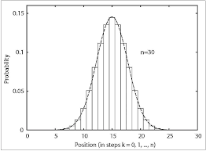
Central Limit Theorem
Therefore, the theorem ensures that the distribution of estimated error_{Si}(h) for different samples S_{i} of at least 30 instances follows a Gaussian (Normal) distribution (the gaussian approximates the binomial distribution) whose mean is the true error p (i.e. error_{D}(h)).

Slide 47
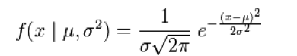
What is a Gaussian Distribution?
1
The curve parameters are the mean μ (e.g., p in our specific case of error rate) and the standard deviation σ.
In a gaussian, for any μ and σ it holds that:
99.7% of the probability mass lies in the area below the mean value μ ± 3σ
95.4% of the probability mass lies in the area below μ ± 2σ
68.3% of the probability mass lies in the area below μ ± σ

Slide 48
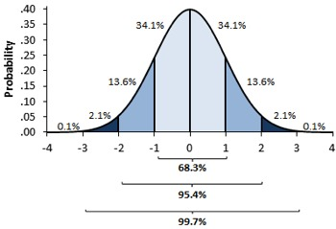
What is a Gaussian Distribution?
2
In our case, the mean μ is p (i.e., error_{D}(h)).

Slide 49

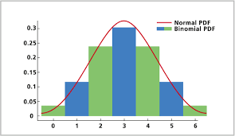
..but..
Why is it important to know that the distribution of error rates is approximately normal (Gaussian)??
Stay tuned...

Slide 50
Standard Deviation of error_{S}(h)
1
Thanks to CLT, we know that
E(error_{S}(h)) = error_{D}(h) = p
Expected value p of “true” error probability and mean of estimated error rates on different samples are the same
What about the standard deviation of error_{S}(h)??

Slide 51
Standard Deviation of error_{S}(h)
2
The Standard deviation of a sample S of n instances is defined as:
Note that for n→∞ (very large samples), then σ_{S}→0
(since r/n→p i.e., the observed error will converge to the real error rate)
We replace the (unknown) p with our computed mean value r/n. This is an estimate since we assume that r/n is a good approximation of the real error rate p, which holds approximately true for large enough n, according to CLT!

Slide 52
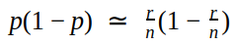
Why is this approximation reasonable?
Why we can set ??
Say p=0.6 and r/n=0.7 (difference is 0.1, 10%)
However, p(1-p)=0.24 r/n(1-r/n)=0.21 (difference is 0.03, only 3%))
→Although approximating the real error with the estimated error can lead to a significant over or under-estimate, approximating the real SD with the estimated SD is much less critical
In general, if n is sufficiently large, the probability that our estimate is very far from real sigma is sufficiently low

Slide 53
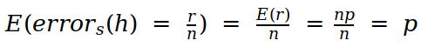
Consequences of the
Central Limit Theorem for error_{s}(h)
Expected Value:
Standard Deviation:
The central limit theorem also implies that the binomial distribution can be approximated by the normal distribution, with its important properties (e.g., 99.7% of the probability mass lies in the area below the mean value μ ± 3σ, 95.4% of the probability mass lies in the area below μ ± 2σ, 68.3% of the probability mass lies in the area below μ ± σ …)

Slide 54
Summary
1
We showed that:
The number of misclassified instances r over n instances is a random boolean variable and P(X=r) follows a binomial probability distribution with mean np, over the full population distribution D.
The sample error, error_{S}(h), is a good estimator of error_{D}(h) because it is a random variable (depending on the selected sample S) that also obeys to a binomial distribution:
Low Bias: error_{S}(h) is an unbiased estimator of error_{S}(h) because for a Binomial distribution (E(error_{S}(h)) = p).
Remember: Bias(error_{S}(h)) = E[error_{S}(h)] - error_{D}(h) = p - p =0
Low Variance: By our definition of variance, this choice will yield the smallest expected squared error between the estimate and the true value of the error rate.

Slide 55
Summary
2
If the number of examples n in any sample S is sufficiently large ( >30), then according to Central Limit Theorem (CLT) the underlying binomial distribution for error_{S}(h) approximates a Gaussian (Normal) distribution and with mean p (error_{D}(h) ).
This does not mean that for n>30, error_{D}(h) = error_{S}(h). It means that, if we repeat the experiment on different independent samples S_{i} of the same dimension n, we obtain different values r_{i}/n_{i} for error_{Si}(h) and the distribution of these values approximates a Gaussian with mean p. Furthermore, for a single experiment with sufficiently large n we have:
Now, we know that the sample error is a good estimator for the true error but how good an estimate of error_{D}(h) is provided by error_{S}(h)? Confidence Intervals

Slide 56
Confidence interval
for an error estimate
Q1
Confidence interval (CI)
Where the ME (Margin Error) = (Critical Value) x (Standard Deviation for the population)
(or the Critical value x Standard Error of the sample). The critical values are also called z-values.
Δ is called Absolute Error
The confidence interval represents the statistical significance (Margin Error; ME) of the expected distance Δ between the real value and the observed estimate. Definition: An N% confidence interval for some parameter p is an interval [LB, UB] that is expected with probability N% to contain p. (with probability N% we have LB≤ p ≤UB)
The confidence interval is a way to show what the uncertainty is with a certain statistic. The margin of error ME tells you how many percentages points your results will differ from the real population value
NOTE: With smaller samples (n< 30) the Central Limit Theorem does not apply, and another distribution called the t distribution must be used.

Slide 57
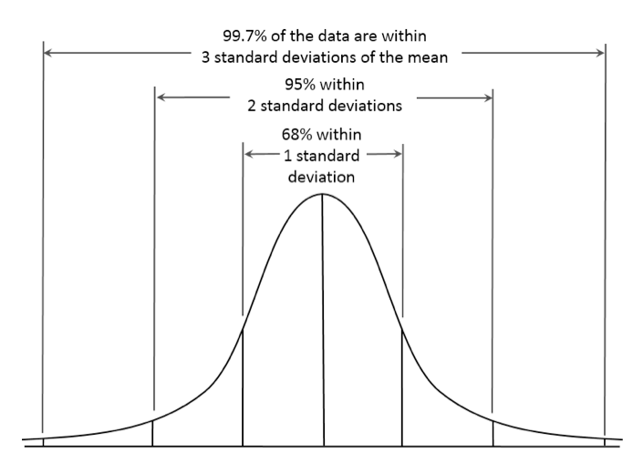
Confidence intervals:
Gaussian Distribution
Δ = | error_{D}(h(x)) - error_{S}(h(x))|
For any gaussian, we can say “with a probability of 68% (95%, 99.7%, N%) any value x we measure for error_{S} will lie in the interval ±1σ (±2σ, ±3σ, ±zσ) around the mean p”. More in general, with an N% probability it will lie in the ±zσ interval
Δ
error_{S}(h)
p
One reason that we prefer to work with the gaussian distribution is that most statistics references give tables specifying the size of the interval around the mean that contains N% of the probability mass under the Normal distribution. This is precisely the information (the critical values, z-values) needed to calculate our N% confidence interval.
Remember that error_{S}(h(x)) follow a gaussian, so we can use it!

Slide 58
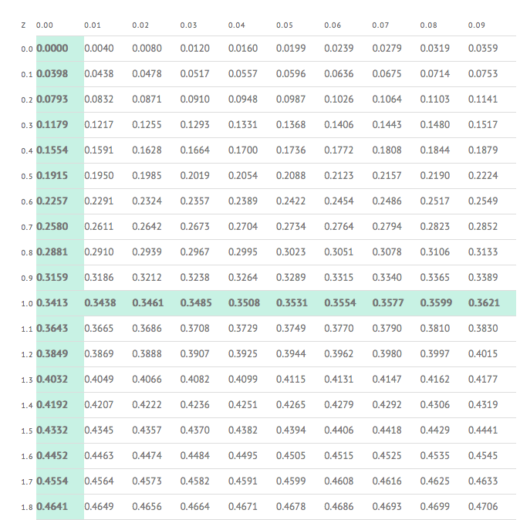
The Z-table:
Gaussian Distribution
0.05
z is HALF of the length of the interval around the mean p that includes N% of the total probability mass. A z-value tells you “how many standard deviations” (z×σ) from the mean p your result r/n is.
1.4
z=(1.4+0.05)=1.45
Highlighted cell says that N =0.4265 x2 (because you are considering only half) = 0.853 = 85.3% of the probability mass lies ±z=(1.4+0.05)=1.45 times the standard deviations around the mean

Slide 59
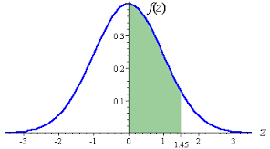
The Z-table:
Gaussian Distribution
The z-value in the table gives you this area (for a mean =0)
The red line is your
z-value (e.g. 1.45)
0.4265 %
Or viceversa if the input is N: Dividing by 2 the probability mass (say, N= 85.3% /2 = 0.4265), we obtain the z (1.45) value from the table, to calculate the interval

Slide 60
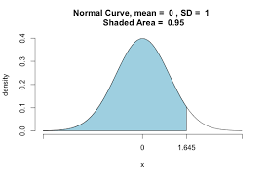
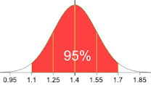
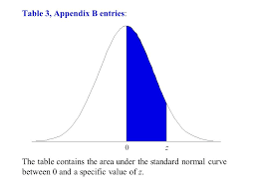
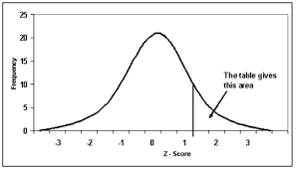
There are different z-tables!
Be aware
The area to the left of zσ
The area in between ±zσ
The area between the mean and zσ
The area to the right of zσ

Slide 61
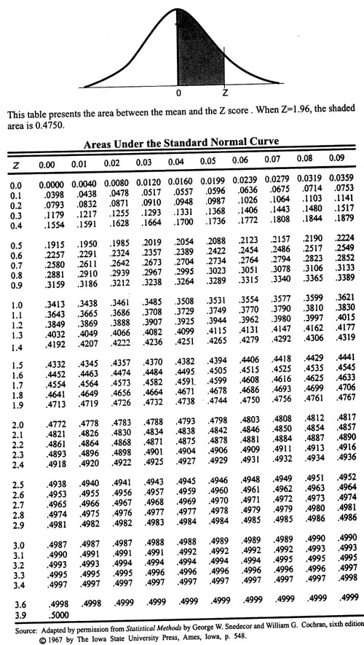
How do I know?
For readable right tail z-table: LINK

Slide 62
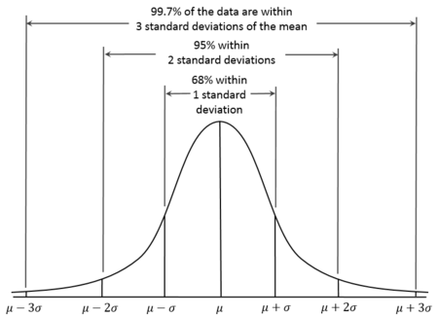
How to do:
Finding the N% confidence interval
1
We don’t know where is our error estimate r/n (the red line) is placed, but we know that with 68.26% probability (68.26% /2= 34,13) it will be at a distance ±1σ from the mean error, with probability 95,44 (68,26+2x13.59) it will be at a distance ±2σ and in general, with probability N% at a distance ±Z_{N}σ (this is because it follows a gaussian distribution)
Where is our error estimate placed?

Slide 63
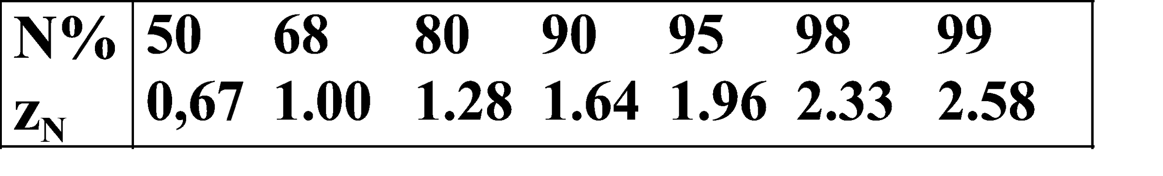
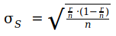
How to:
Finding the N% confidence interval
2
To determine the confidence interval we need to fix either z or N
If N is the known parameter: (we want to compute, e.g. the 80% confidence interval).
We know that N% of the probability mass lies between p ± zσ
The z-table gives us the z value for any N/2%,
For example, if N=80% (e.i. 0.80/2=0.40⋍0.3997) then z=1,28: we know that with 80% probability our estimated error is ±1,28σ far from the true error.
And:

Slide 64
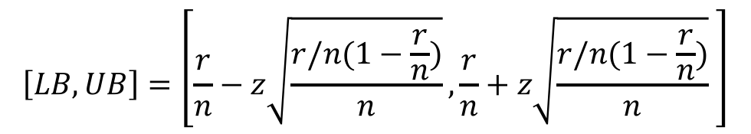
How to :
Finding the N% confidence interval
3
We know the formula to compute the interval, given the estimated error rate:
In this formula, z is unknown. But we fixed N, so we look in the table and we obtain z for the desired N, and compute the interval.

Slide 65
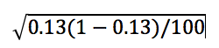
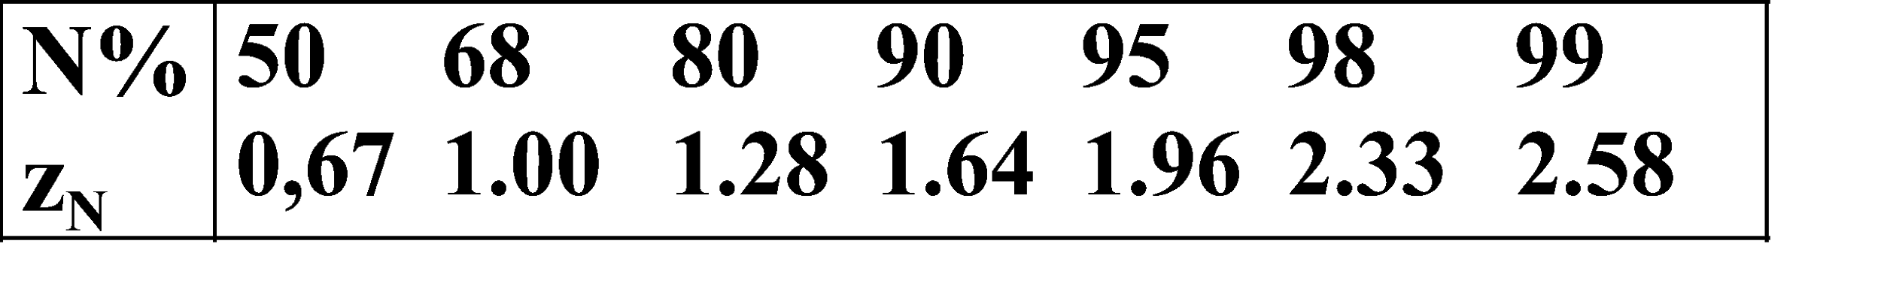
Example
1
We have a classifier which produced a hypothesis model h(x), and a test set S of 100 instances
We apply h(x) on the sample test set S and compute 13% (0.13) error rate (r/n)
Since n>30 we assume that the error distribution follows a gaussian distribution with mean 0,13 and standard deviation σ_{S}:
To compute the N=90% confidence interval, on the table we find Z=1.64

Slide 66
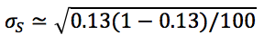
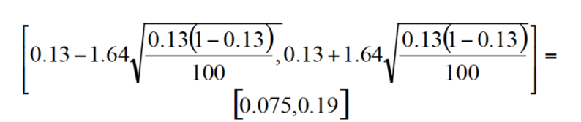
Example:
Calculating the N% Confidence Interval
2
We then have:
Z=1.64 and
The 90% confidence interval is estimated using the previous formula is:

Slide 67

Example 2:
Finding 95% CI on a face recognition task
1

Slide 68

Example 2:
Solution
2
Accuracy is 0.78, hence error rate is 0.22; the test set has 50 instances, hence n=50.
Choose, e.g., to compute the N% confidence interval with N=0.95

Slide 69
One side bound (Tailed-test)
We might be interested in computing the probability that the error of our ML system is “at most” a given value, rather than within a given range like before.
Which amounts to computing the blue area
Now N% is the area for which error_{S} ≤ zσ

Slide 70


Gaussian is symmetric!
One-sided / Two-sided bounds: The Gaussian distribution is symmetric and its total area is 100% (of the probability mass).
P(x)<=L
L<=P(x)<=U
P(x)>=U
P(x)<=U
P(x)>=L

Slide 71

Example:
One/Two-Sided
In the previous emotion recognition example, we said that with 95% probability (the confidence), the true error (i.e error_{D} ) lies in the [0.11,0.34] interval.
There is a 5% (100-95=5) area outside this interval, of which, 2.5% to the left and 2.5% to the right (due to symmetry)
Therefore, we can also say that there is a 2.5% probability that error_{D} > 0.34 (the upper bound UB) and 2.5% probability that error_{D} < 0.11 (the lower bound LB)
There is a 97.5% (95+2.5=97.5) probability that: error_{D} < 0.34
There is a 97.5% (95+2.5=97.5) probability that: error_{D} > 0.11

Slide 72
Issues
Which performance measure we should use?
How well can a classifier be expected to perform on “novel” data, not used for training?
Since a performance measure is an estimate on a sample, how accurate is our estimate?
How to compare performances of different hypotheses or those of different classifiers?

Slide 73
Comparing
Two Learned Hypotheses
1
When evaluating two hypotheses (e.g. using different hyper-parameters on the same ML algorithm), their observed ordering concerning accuracy may or may not reflect the ordering of their true accuracies.
Assume h₁ is tested on the test-set S₁ of size n₁
Assume h₂ is tested on the test-set S₂ of size n₂
error_{S1}(h₁)
error_{S2}(h₂)
P(error_{S}(h))
error_{S}(h)
Observe h₁ more accurate than h₂

Slide 74
Comparing
Two Learned Hypotheses
2
When evaluating two hypotheses (e.g. using different hyper-parameters on the same ML algorithm), their observed ordering concerning accuracy may or may not reflect the ordering of their true accuracies.
Assume h₁ is tested on the test-set S₃ of size n₁
Assume h₂ is tested on the test-set S₄ of size n₂
error_{S3}(h₁)
error_{S4}(h₂)
P(error_{S}(h))
error_{S}(h)
Observe h₁ less accurate than h₂

Slide 75
Alternative Hypothesis Tests
Q2.1
When we wish to understand how much we can rely on a statistical finding (e.g., that an ML model h2 is more precise than h1 on a sample dataset), we need to list the alternatives (e.g. h2 in not more precise than h1 on the entire population).
One of these alternatives is called the Null Hypothesis H0
Usually, the null hypothesis disconfirms our findings

Slide 76
Alternative Hypothesis Tests
Q2.2
Suppose we measured the error rate of h1 and h2 finding that d = error_{S1}(h1) - error_{S2}(h2) ≠ 0; we can perform 3 different tests:
Two-Tailed Test (|d|≠0):
H0: data do not support that h1≠h2 (hence error_{D}(h1) - error_{D} (h2) could actually be 0)
H1: data support that h1≠h2 (d is either positive or negative; with high confidence our finding is true; like N=95%)

Slide 77
Alternative Hypothesis Tests
Q2.3
Suppose we measured the error rate of h1 and h2 finding that d = error_{S1}(h1) - error_{S2}(h2) ≠ 0; we can perform 3 different tests:
One-tailed right-test (d>0)
H0: data do not support that h2>h1
H1: support h2>h1 (error of h1 is significantly lower)
One-tailed left-test (d<0)
H0: data do not support that h2<h1
H1: support h1>h2 (error of h1 is significantly higher)

Slide 78

How to do:
Two-Tailed Test
1
Assumes:
h1 is tested on the test-set S₁ of size n₁
h2 is tested on the test-set S₂ of size n₂
n₁>30, n₂ >30 to hold the Central Limit Theorem
Note: for CLT, binomial is approximated by Gaussian, so both error_{s1}(h1) and error_{s2}(h2) approximately follow a gaussian distribution.
Suppose we wish to estimate the difference d_{D} between the (unknown) true errors of these two hypotheses:
As usual, define d_{S} the estimator of d_{D} with the known sample errors:
d_{S} is an unbiased estimator of d_{D}. We will not give the proof.

Slide 79
How to do:
Two-Tailed Test
2
To obtain the confidence interval we need to compute the σ_{ds}:
Note: What is the probability distribution governing the random variable? For CLT, we know that both error_{s1}(h1) and error_{s2}(h2) follow distributions that are approximately Gaussian. Because the difference of two Normal distributions (Gaussian) is also a Normal distribution, d_{S}will also follow an approximately Normal distribution, with mean d_{D} and variance:
Note: It can also be shown that the variance of this distribution is the sum of the variances of error_{s1}(h1) and error_{s2}(h2)
Notes:
.

Slide 80

How to do:
Two-Tailed Test
3
If H0 (null hypothesis) holds true, then we must have:
error_{D}(h1) = error_{D} (h2) ⇒ d_{D}=0
Which means: although in our experiments we observe that error_{S}(h1) ≠ error_{S}(h2) (e.g.,error_{S}(h1) < error_{S}(h2)), the “true” expected value of error differences of h1 and h2 on D is zero.
To test the likelihood of H0, we have to consider:
Error estimates on the samples
d_{D} must be zero if H0 holds true
Error bounds in estimating d_{S}
We know both d_{S} and σ_{ds} so we compute z and look on a z-table, to see“how many times” our result d_{S} is far from the expected mean difference (which is zero according to H0)

Slide 81

How to do:
Two-Tailed Test
4
If the area lies within the non-critical region (i.e. N≤95%), the Null Hypothesis H0 is accepted (= there is no significant difference between the two hypotheses)
|d_{S}-0|=zσ , z=|d_{S}|/σ
Given z, using the table we can compute N (the confidence area).
The “common wisdom” is that the acceptance region for H0 is within -2σ and +2σ (N≤95%)
We estimate d_{S} on the sample
If H0 holds, d_{D}=0

Slide 82
How to do:
Two-Tailed Test
5
In other terms: the farther our measured distance d_{S} is from the “expected” distance (d_{D}=0; in case the null hypothesis H0 holds), the less confident we should be in H0.
For any measured value of d_{S}, the y-axis gives us the probability of observing that value
If d_{S} is farther than ±2σ from d_{D}, then we may conclude that the probability of having observed the value d_{S} in case d_{D}=0 is too small. And hence we reject H0 as being very unlikely.

Slide 83

How to do:
Example of Two-Tailed Test
6
Assume:
d_{S}=0.15
σ_{S}=0.05
z=d_{S}/σ=3
Then ⇒ N=99,87%

Slide 84
How to do:
Example of Two-Tailed Test
7
Our z-test says that, if d_{D}=0, the probability to obtain the value d_{S}=0.15 or more, is less than 0.13% (100-99,87)!! So H0 is very unlikely
We should reject H0!!
0.065%+0.065% = 0.13%
99.87%
Z=3

Slide 85

p-value
The p-value is the “probability value” of observing our estimate, given that H0 holds.
The common wisdom is to reject the null hypothesis if p<0.05 (5% the area under the curve of the tails) (same as saying that the estimated value lies outside the ±2σ interval, or outside the 95% probability mass around the mean)
In the previous example, we obtained p < 0.0013 (0.13%)

Slide 86

How to do:
One-Tailed Test
1
For the 1-tailed test the p-value = 0.05 (5%)
Then, the right area is 0.95 (95%) of the total area
In a one-tailed test we test either h1>h2 or h1<h2
In case h1>h2, we state the null hypothesis as follows:
H0: not support that h1>h2 (hence h1≤h2)
H1: support h1>h2 (in this case we should get an estimate of d )

Slide 87




How to do:
Example of One-Right tailed test
2
Right-tailed test ( h2 > h1 ( d>0)):
error_{s1}(h1)= x1=17.5%, error_{s2}(h2)= x2=12.4%, d=5.1% (0.51)
n₁=50, n₂=50
N=0.2327 = 23.27%⇒ p>0.05
The null hypothesis is accepted:
The difference is not large enough to support h1<h2 (p is not lower than 0.05)

Slide 88

Summary:
Two-Tailed Test

Slide 89
Comparing
Two Learning Algorithms
Q3
Comparing the average accuracy of hypotheses produced by two different ML algorithms is more difficult. Ideally, we want to measure:
where L_{X}(S) represents the hypothesis learned by learning algorithm L_{X} from training data S.
To accurately estimate this, we need to average over multiple, independent training and test sets.
However, since labeled data is limited, generally must average over multiple splits of the overall data set into training and test sets (K-Fold Cross Validation, see the beginning of this lesson).

Slide 90
Summary:
K-Fold Cross-Validation
Every example in D used as a test example once and as a training example k–1 times.
All test sets are independent; however, training sets overlap significantly (see two previous slides).
In total, we test on [(k–1)/k]⋅|D| training examples.
The standard method is 10-fold.
If k is low, not a sufficient number of train/test trials; if k is high, the test-set may be too small and test variance is high and run time is increased.
If k=|D|, the method is called leave-one-out cross-validation (at each step, you leave out one example). Used for specific cases (e.g. learning recommendations)

Slide 91


How to use:
K-Fold Cross Validation to evaluate different learning algorithms
Randomly partition dataset D into k disjoint equal-sized (N)
subsets P₁…P_{k}
For i from 1 to k do:
Use P_{i} for the test set and remaining data for training
D_{i} = (D – P_{i})
h_{A} = L_{A}(D_{i})
h_{B} = L_{B}(D_{i}) (learn models on D_{i} )
δ_{i} = error_{Pi}(h_{A}) – error_{Pi}(h_{B}) (test models on P_{i} and compute difference)
Return the average difference in error:
Error bound is
computed as:

Slide 92
Is L_{A} better than L_{B}?
K-fold cross-validation improves confidence in our estimate of δ since we are performing many experiments and computing δ as the average of δ_{i}.
As K grows this average tends to the true mean difference (however we cannot make K too big since individual samples should be large enough for the CLT to apply)
We can, in any case, apply hypothesis testing as before

Slide 93
Example:
Sample Experimental Results
Which experiment provides better evidence that SystemA is better than SystemB?
Experiment 1
Experiment 2
 | SystemA | SystemB
Trial 1 | 87% | 82%
Trail 2 | 83% | 78%
Trial 3 | 88% | 83%
Trial 4 | 82% | 77%
Trial 5 | 85% | 80%
Average | 85% | 80%
δ
+5%
+5%
+5%
+5%
+5%
+5%
 | SystemA | SystemB
Trial 1 | 90% | 82%
Trail 2 | 93% | 76%
Trial 3 | 80% | 85%
Trial 4 | 85% | 75%
Trial 5 | 77% | 82%
Average | 85% | 80%
δ
+8%
+17%
–5%
+10%
– 5%
+5%
Experiment 1 mean δ has σ=0, therefore we have perfect confidence in the estimate of δ

Slide 94
Experimental Evaluation: Conclusions
Good experimental methodology is important for evaluating learning methods.
Important to test on a variety of domains to demonstrate a general bias that is useful for a variety of problems. Testing on 20+ data sets is common.
Variety of freely available data sources
UCI Machine Learning Repository (link)
KDD Cup (large data sets for data mining) (link)
CoNLL Shared Task (natural language problems)(link)
Data for real problems is preferable to artificial problems to demonstrate a useful bias for real-world problems.
Many available datasets have been subjected to significant feature engineering to make them learnable.

Slide 95
If something isn't clear...
Metrics: link, link, link, link, link
Basic statistics: link
Bias, Variance, and Error: link, link, link
Estimator: link, link
Estimating the accuracy of a hypothesis/Confidence Interval:
Text: link, link, link, link, link, link
Video: link
Hypothesis testing: link, link, link
Z-table: link

